Slide 1


Slide 2

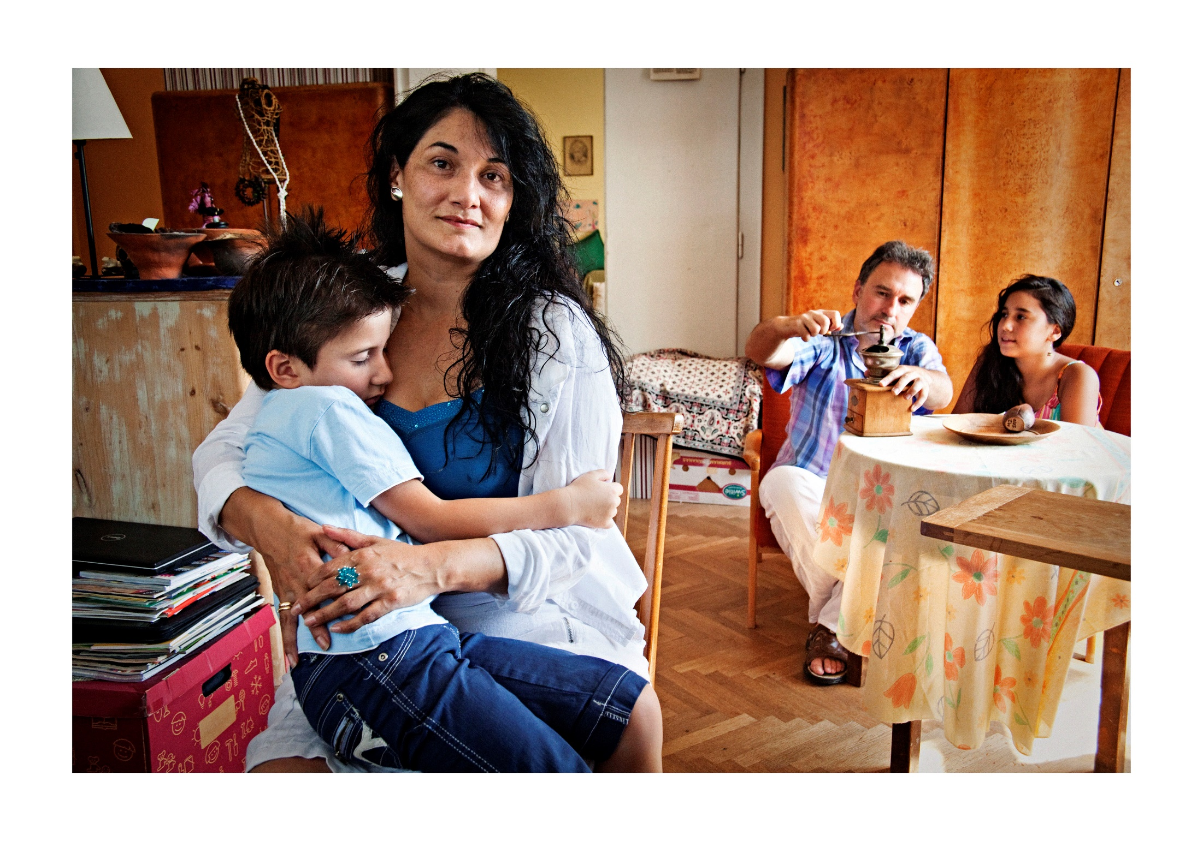

Slide 3


Slide 4
PROCESS AND PUBLICATION STRUCTURE:
1. Observing the reality on the ground
2. Our vision on an inclusive Europe
3. Actions/solutions to foster integration processes

Slide 5


Slide 6
MAIN FINDINGS
Active involvement of migrants
Empowering their active participation into society
Showcase their positive contributions
Innovation

Slide 7
MAIN FINDINGS
Specific focus on the most vulnerable
Partnerships at local level
Better monitoring

Slide 8
RECOMMENDATIONS TO EUROPEAN STATES
Implement national integration strategies
Avoid competition for economic resources
Access to good quality healthcare
Effective housing policies

Slide 9
RECOMMENDATIONS TO EUROPEAN STATES
Access to education for migrants
Protect undocumented migrants’ rights and dignity
Empower migrants and receiving communities to be active contributors to society

Slide 10
