Slide 1

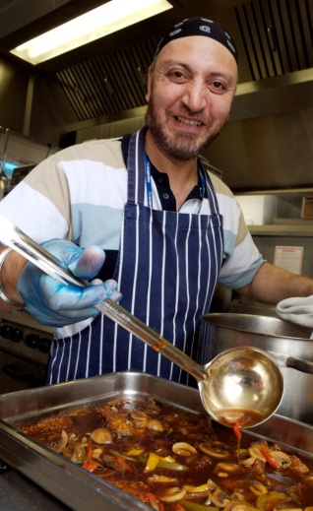
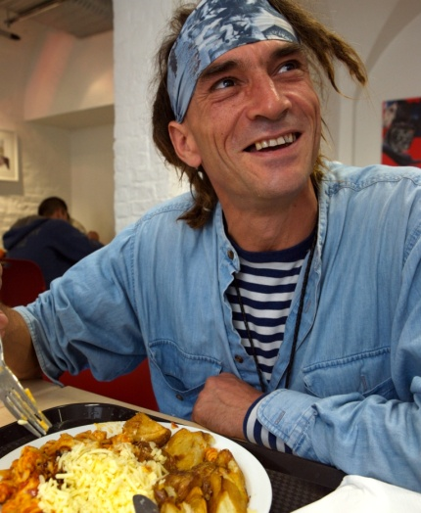
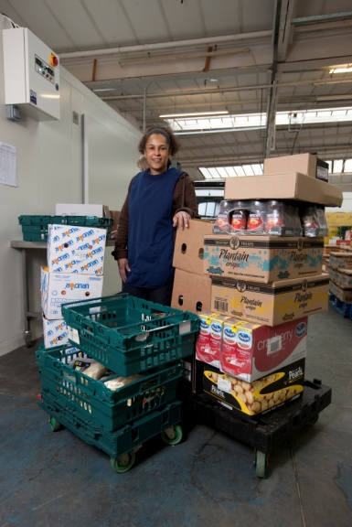
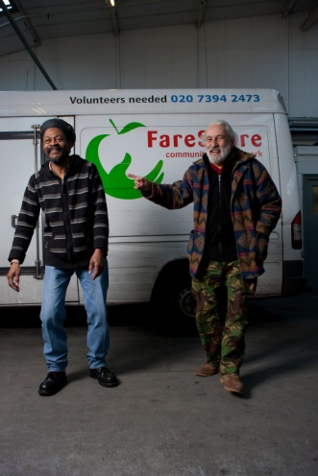
FareShare
Fighting hunger, tackling food waste
Jonathan Pelluet
Head of Fundraising

Slide 2
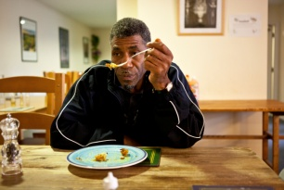
The Issues & the Need...
Food poverty & hunger in the UK is rising at a shocking rate and more and more people are having their lives blighted by hunger.
5m people are effected by food poverty
one in three people have cut back food spending to cover the cost of rent
37% of children in London live in households with income below the poverty line
The charity sector plays a key role:
60% of charities we support have seen an increase in the demand for food since 2012
40% of the charities we support are facing funding cuts
70% fear demand for food will increase in the future.

Slide 3

....at the same time
Good food is needlessly going to waste
3 million tonnes of food is wasted every year from the food industry
around 13% of this – 400,000 tonnes – is safe, edible and could be eaten by people who really need it....
...NEARLY 1,000,000,000 MEALS!!!

Slide 4



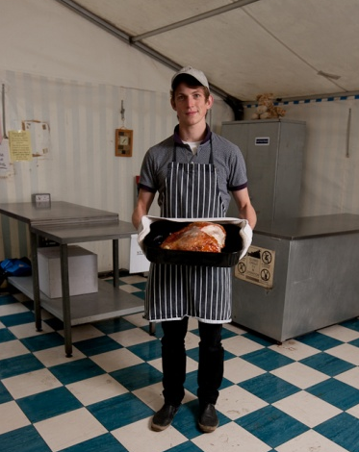

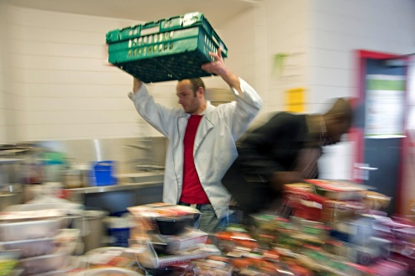
FareShare’s work....
FareShare rescues edible ‘surplus’ food from the food industry - 3,600 tonnes (8.5m meals) in 2011/12...
Our 800 volunteers sort the food at our 17 depots, & deliver it using our 25 delivery vehicles...
Fighting hunger by tackling food waste
...and 35,000 disadvantaged people everyday enjoy food provided by FareShare.
The 760 grassroots community projects we support use this for their vulnerable clients...

Slide 5
Grass-roots front-line impact
In London alone, FareShare serves over 110 grass-roots charities and community groups, benefitting over 5,000 people every day.
Kids Company is a charity which provides practical, emotional and educational support to many of London's most vulnerable children
“Our food programme transforms young lives, restoring hope, happiness and good health to thousands of children struggling against poverty and maltreatment. FareShare plays a vital role in helping us to achieve this."

Slide 6




FareShare’s position
Our impact (actual and potential) is recognised through the public, charity and commercial sectors:
Associateof FEBA and Global Foodbanking Network
Minister-level working relationships with DEFRA
CEO level relationships with the food industry
Recognised by the UK charity sector – award winning

Slide 7


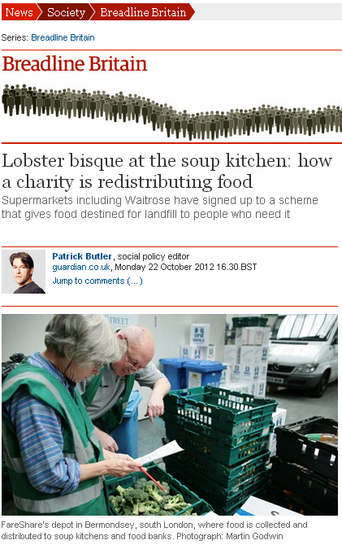





Recognition of the issues & impact

Slide 8
Potential impact
Based on steady growth, our 5 Year Strategy sees:
1,200 charities supported catering for 60,000 disadvantaged people every day
Collectively supporting the voluntary sector to save £16 million on their budgets
FareShare Rural – a new model to reach vulnerable people outside cities
Public food collections – food, funds and pressure on industry
... but, although huge impact, these ambitions are cautious

Slide 9
Ingredients to deliver impact
FareShare needs 3 key ingredients to deliver this impact:
Food – currently accessing < 1% of surplus. Massive potential to rescue more
Funds – supporting access, management & transportation of food
Volunteers – the life blood of the charity
FEAD would accelerate and transform our ability to meet the huge need across the UK

