Slide 1
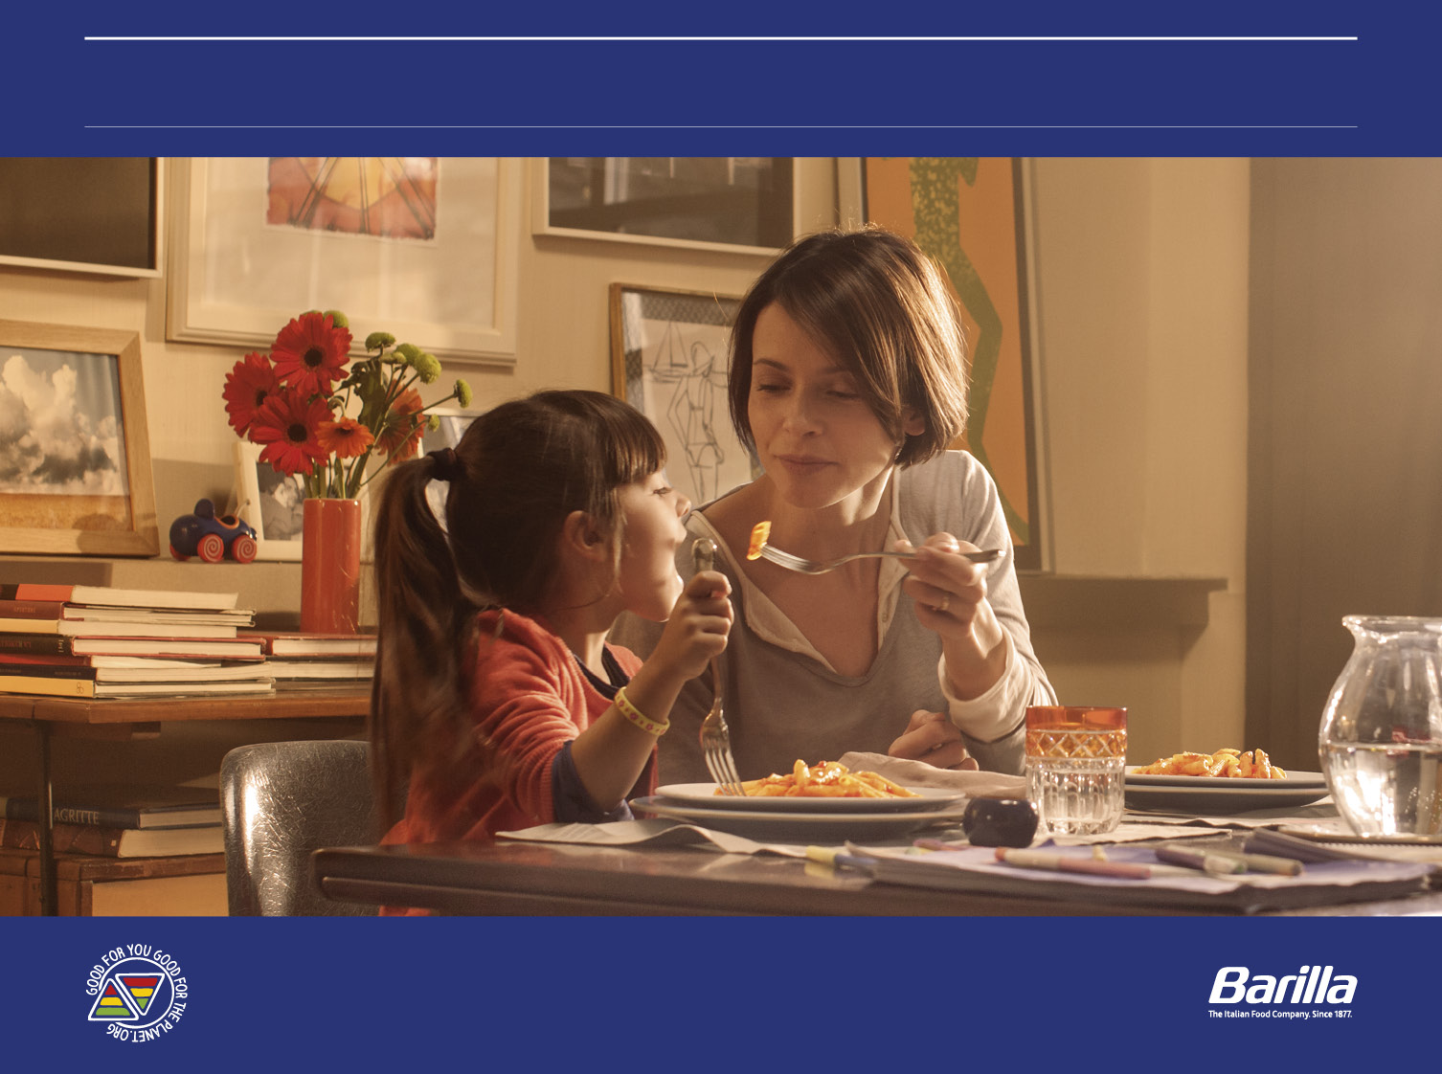
GOOD FOR YOU, GOOD FOR THE PLANET, GOOD FOR THE COMMUNITY
19/10/2016
Lorenzo Sironi – Belux Managing Director

Slide 2



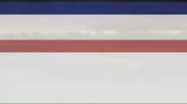
OUR COMMITMENT IN THE PROJECT
Amplify the message
Collaborate with other partners
WHY WE HAVE SUPPORTED THE PROJECT
Our DNA
Our ambition
The Italian food company since 1877
One of the most reputable companies

Slide 3

OUR PURPOSE AS A COMPANY
“Give people food you would give to your own children ”
Pietro Barilla
Notes:
.

Slide 4
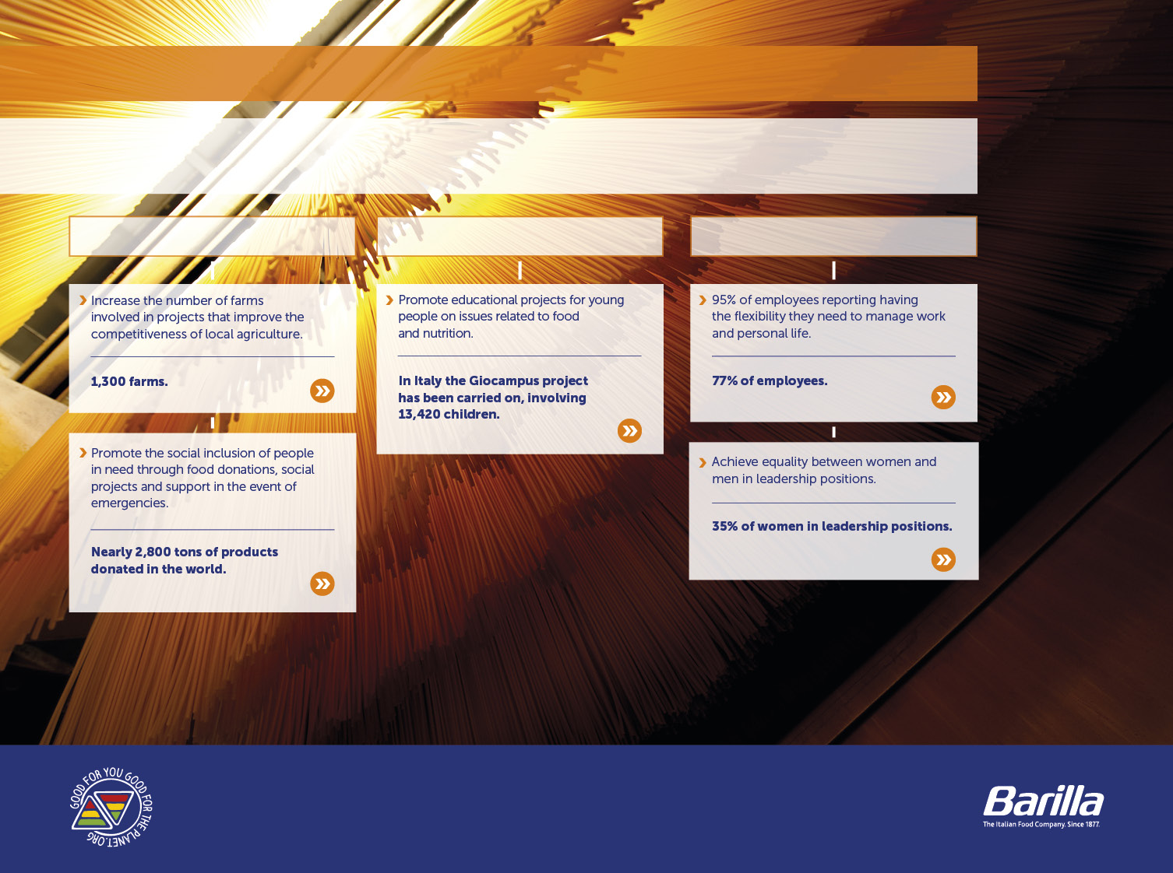
GOOD FOR THE COMMUNITIES
ENCOURAGING THE INCLUSION OF ALL
Barilla promotes the inclusion of people through programs for access to food, educational projects and the promotion of diversity.
SOCIAL INCLUSION
EDUCATION
BARILLA PEOPLE

Slide 5
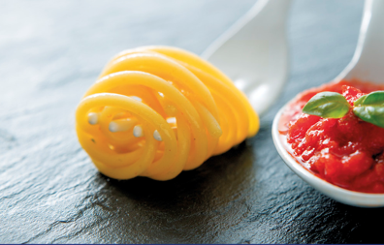
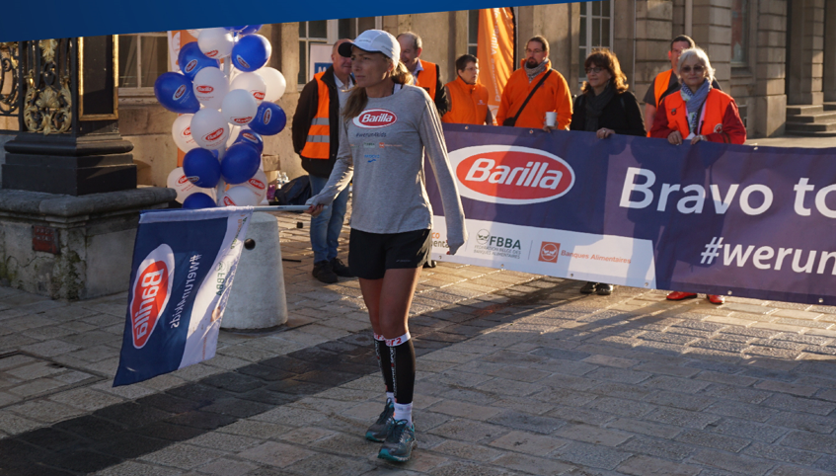
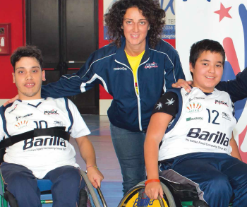

OUR PROJECT IN BELGIUM
1
2
3
2016
2017
2018+
Define scope and objectives
Meet with associations
Launch a pilot project
Choose our partner
Define our contribution
Find our local heroes
Scale up
Build a network
Build a communication platform

Slide 6

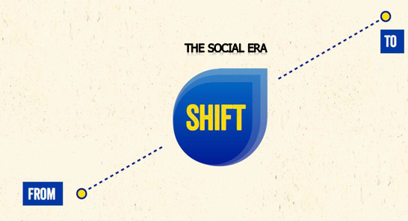

A NEW WAY OF DOING BUSINESS
The social era
Marketing storytelling
One-way communication
Expectation that business will contribute to internal profits
Total transparency
Reciprocity
Expectation that business will contribute to society

