Slide 1

The National Protection System for Asylum Seekers and Refugees (SPRAR)

Slide 2
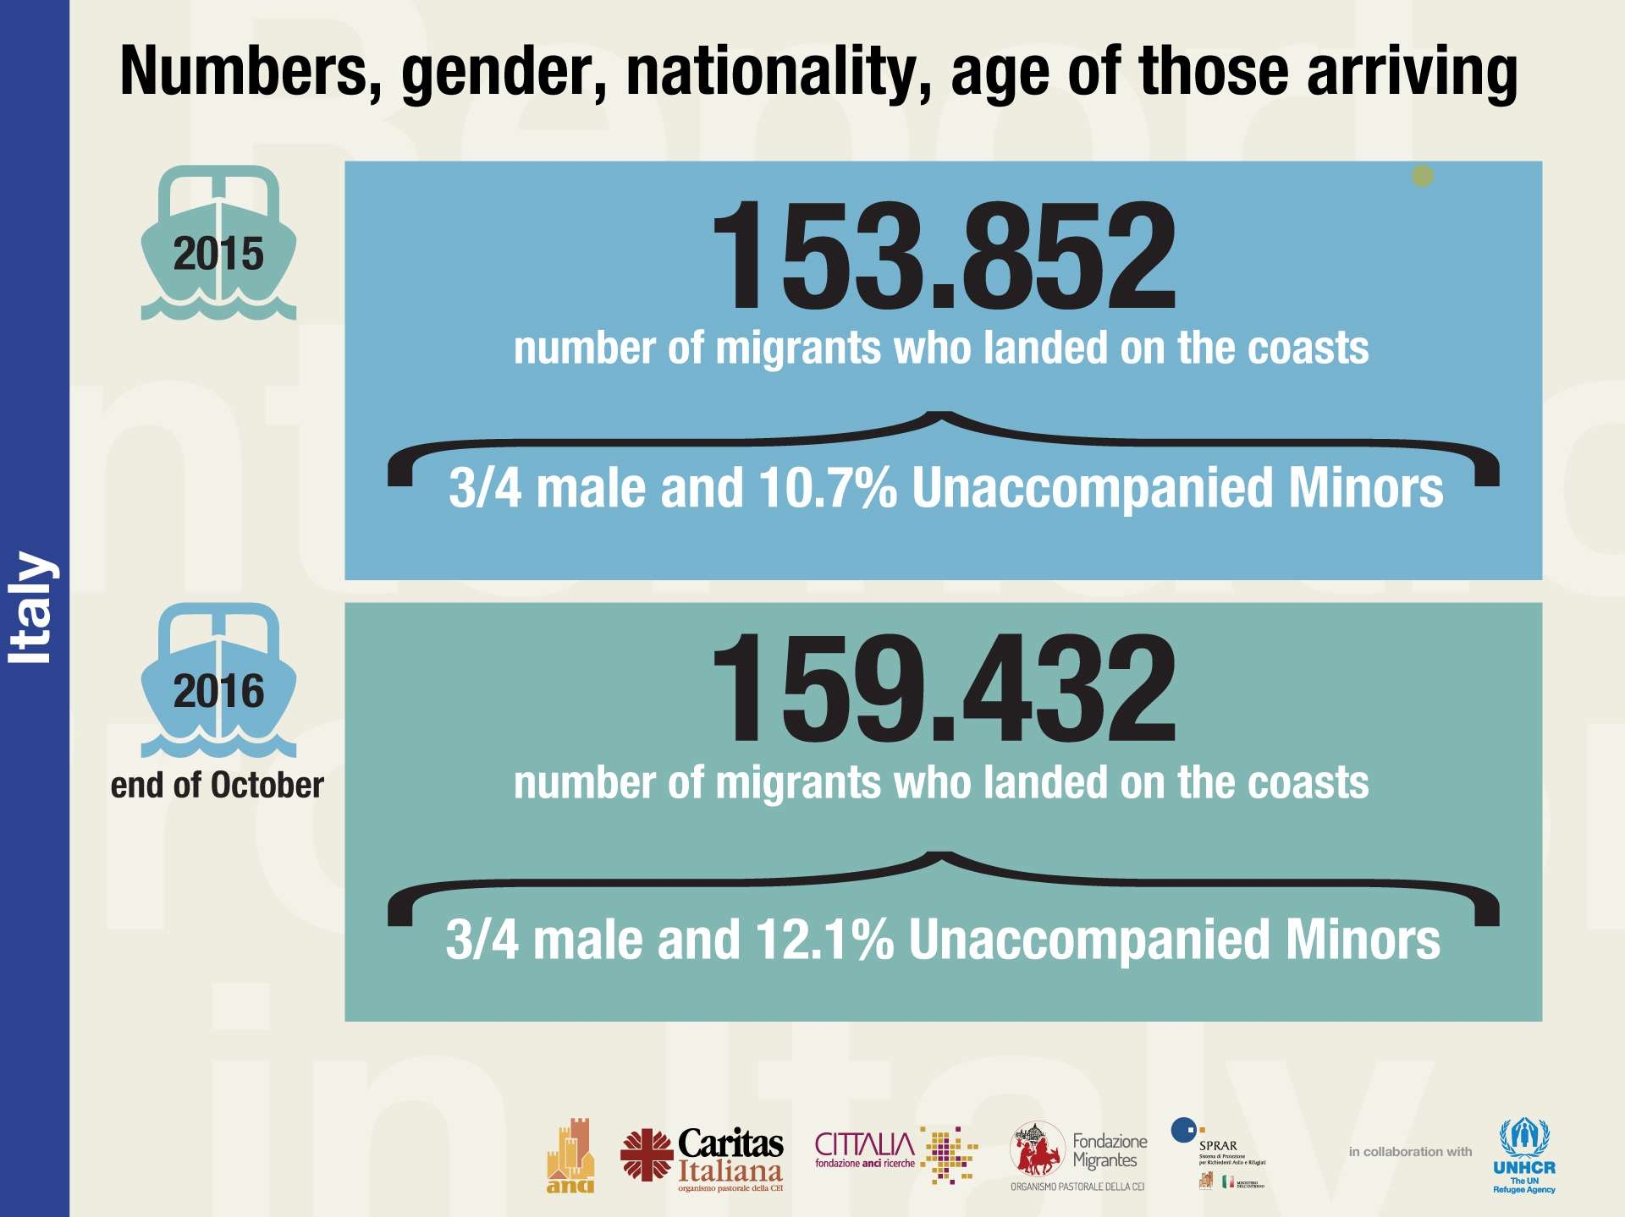

Slide 3
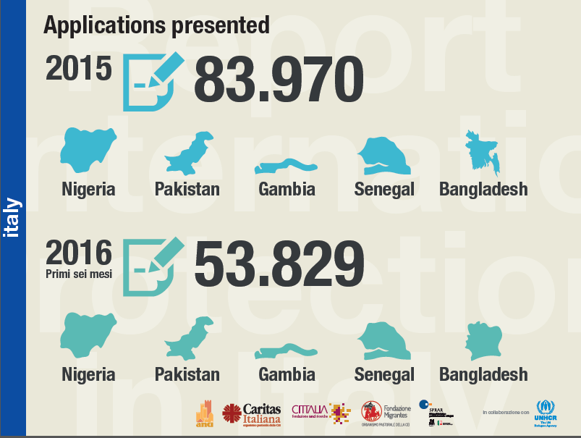

Slide 4
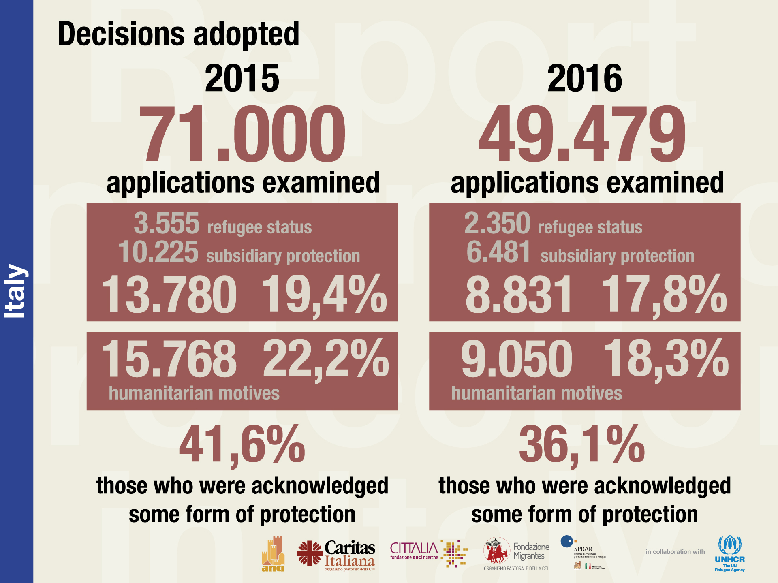

Slide 5

The Reception system in Italy
SPRAR (the National Protection System for Asylum Seekers and Refugees)
Reception Centres for Asylum Seekers (CARA)
Temporary Reception Centres (CAS)

Slide 6

What is “SPRAR”?
The National Protection System for Asylum Seekers and Refugees (SPRAR) is the Italian network for reception and integration of people seeking and granted international protection

Slide 7

SPRAR - How does it work?
The Italian reception system is based on the collaboration between different levels of government
Ministry of the Interior
ANCI-National Association of Italian Municipalities
Local authorities with the involvement of the so-called third sector (NGO’s, associations)

Slide 8
The SPRAR network
This national network is the result of all the local reception and integration projects with respect and according to the guidelines established by the Ministry of Interior

Slide 9
Our history
The Immigration law n.189/2002 (so-called Bossi-Fini Law), on the base of a previous and successful experimental project, established:
The National Protection System for Asylum Seekers and Refugees (SPRAR)
The Central Service
The Fondo nazionale per le politiche e i servizi per l’asilo (FNPSA) – The National Fund for Asylum Policies and Services

Slide 10

The Central Service
(Servizio centrale)
Established by art. 32 of Law 189/2002 and activated by the Ministry of the Interior, a convention entrusts its management to ANCI
and the technical support of activities linked to the local projects of reception
is responsible for the coordination

Slide 11

The Central Service’s Tasks
Central Service’s tasks:
Managing of the national data bank
Monitoring of the activities locally undertaken for asylum seekers and refugees
Providing technical assistance and consultancy to local projects, including setting up services, operators training and monitoring of projects’ quality standards with regard to Sprar guidelines
Supporting for information and awareness-raising activities

Slide 12

Integrated reception programme
NOT ONLY food and shelter provision
Personalized socio-economical project for each beneficiary
Social, psychological and legal assistance and information
Awareness/Information campaigns at local level
Local networks
Italian language learning

Slide 13

Key words of SPRAR
Public nature of the resources
Synergies
Decentralization of “integrated reception” actions
Local networks
Specific skills
Voluntary nature

Slide 14

Key words of SPRAR:
Public nature
Public nature of both the resources made available and of the bodies that are politically responsible for providing reception - Ministry of the Interior and local authorities according to the multilevel governance approach

Slide 15
Key words of SPRAR:
Synergies
Synergies, started on the territory with the “managing bodies”, third sector players – associations. NGOs, cooperatives – that offer an instrumental contribution to the implementation of the interventions

Slide 16
Key words of SPRAR:
Decentralization
Decentralization of “integrated reception” actions, carried out across the national territory with a presence in all the Regions (except for Valle d’Aosta)

Slide 17
Key words of SPRAR:
Local networks
Local networks – stable, solid, interactive – promoted and developed with the involvement of all players and special interlocutors for the success of the reception, protection and social inclusion measures adopted

Slide 18
Key words of SPRAR:
Specific skills
Specific skills of operators, strengthened over the years by in-the-field experience, by training and updating, ensured also at the central level

Slide 19
Key words of SPRAR:
Voluntary nature
Voluntary nature of the local authorities’ participation in the network of projects for reception, bearing witness to the political engagement by the local administrations in choosing to plan the interventions to be carried out in their territory of competence in favour of asylum seekers and refugees

Slide 20
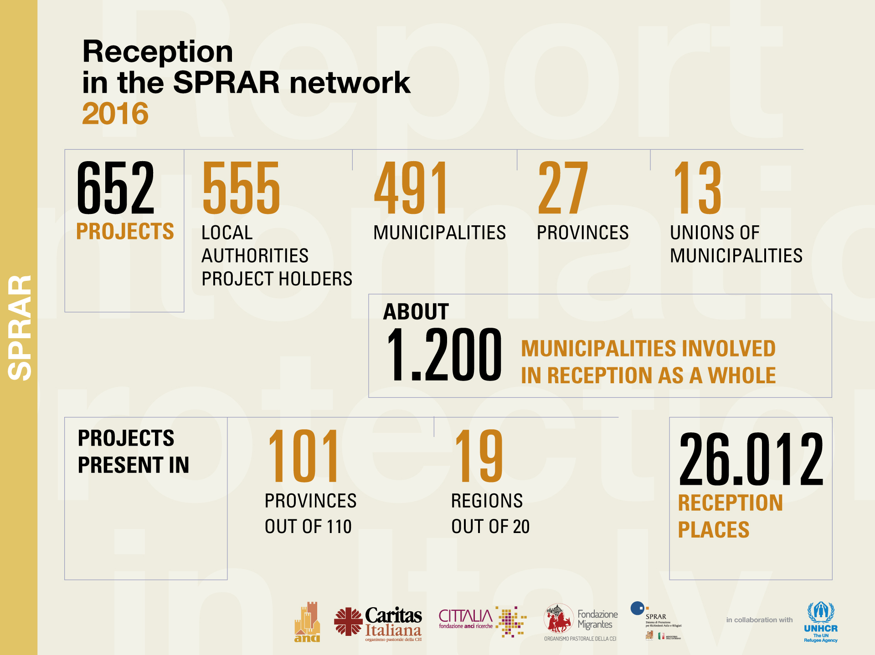

Slide 21
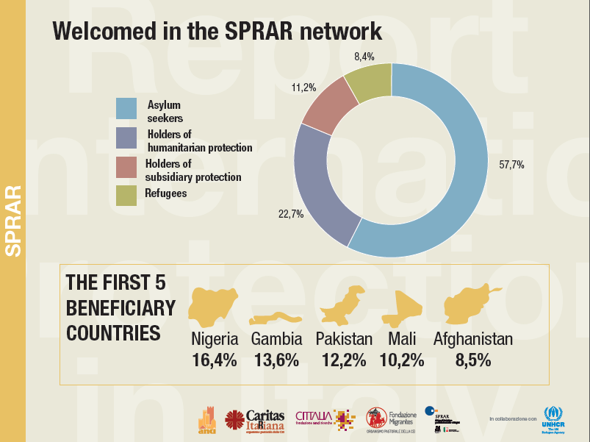

Slide 22
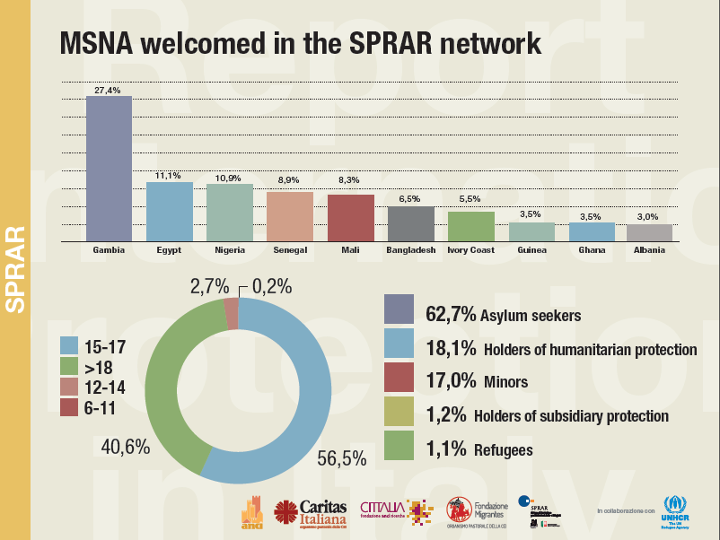

Slide 23

Best practices
Montalto Uffugo (Cosenza): refugees teaching English to local citizens #education
Canelli and Calamandrana (Alessandria) launched “Maramao” a farming start-up that involves local inhabitants and refugees in the organic agricolture #agricolture
Barcellona Pozzo di Gotto (Messina): refugees and asylum seekers launched “Radio Sprar”, a local radio station to showcase their stories #communication
Santorso (vicenza): refugees and asylum seekers created the Nuele Atelier, a sewing Lab in the Santorso village #fashion
Valderice (Trapani) promoted “I sapori dell’Inter-cultura”: on a land confiscated to the mafia, the refugees cultivate the local products. The municipality of Valderice has provided the land under a loan for use agreement #againstmafia #agricolture

Slide 24
Best practices
Trento: the story of Alì, a young refugee, hired in a historic bakery based in the centre of Trento #food
Asti - “La polenta dei rifugiati”: refugees and asylum seekers sow and harvest a typical variety of corn from the Piedmont Region with using organic farming techniques #Agricolture
Giarre (Catania): two refugees participated to the Barcelona ORC world championship 2015 (i.e. the World sailing offshore) #sport
Bologna cares! #communicationcampaign: the campaign aims at actively involve the citizens throughout the whole year, focusing in particular on the days around the World Refugee Day on June 20th. Bologna’s local administration aspires to raise awareness among the citizens on the topic of asylum seekers’ and refugees’ reception
Naples: Tobilì is a multicultural catering managed by the refugees #enterprise #job

Slide 25
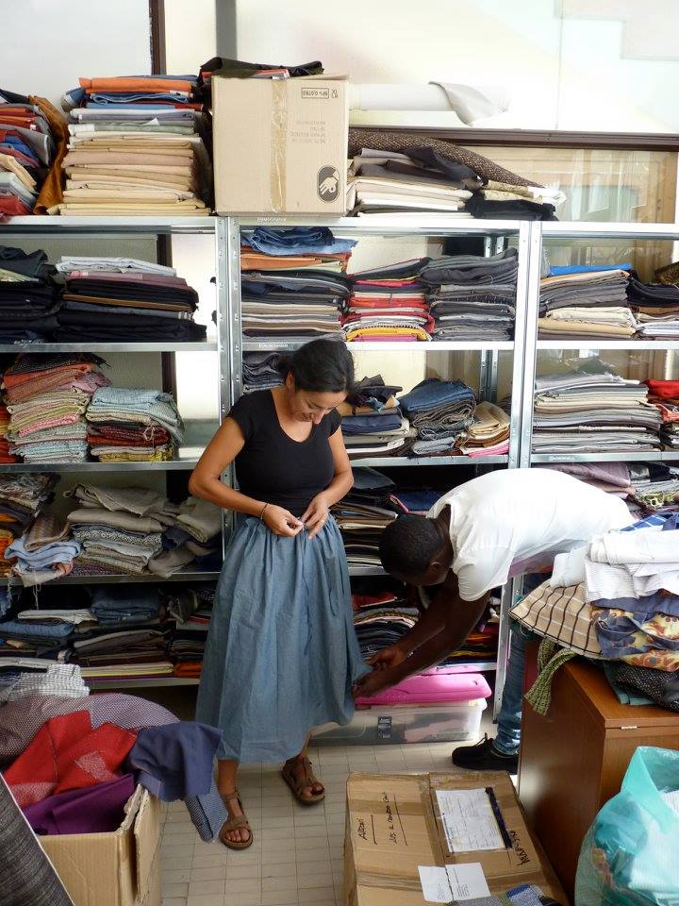

Best practices
The Nuele Atelier
Facebook page

Slide 26

Best practices
Bologna Cares! Our city is doing its part
website

Slide 27
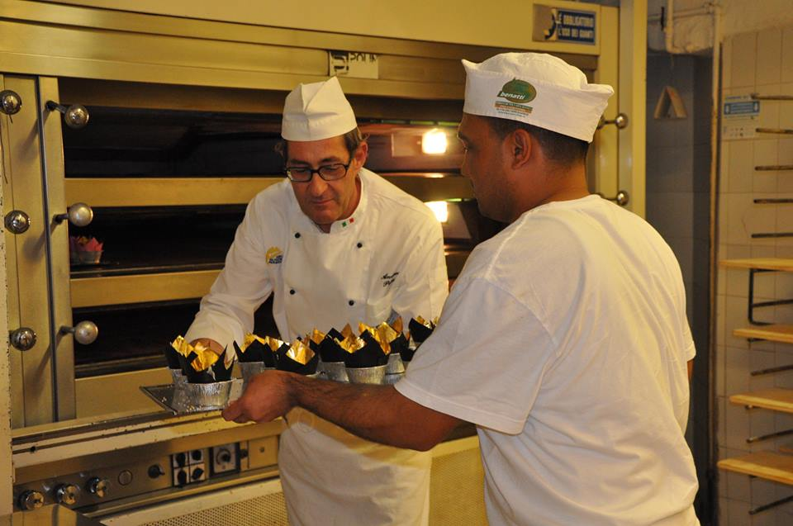

Best practices
Alì at work in the Bakery (Trento)

Slide 28
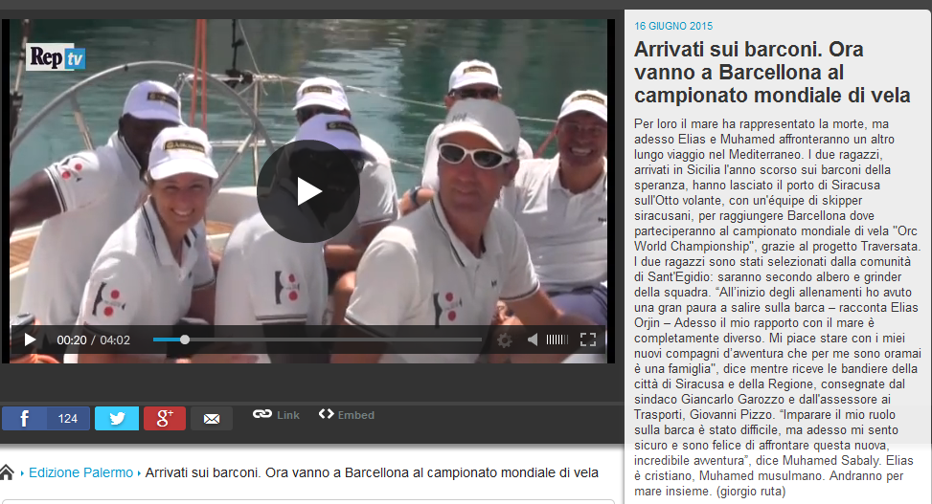
Best practices
Barcelona ORC World Championship 2015
(video)

Slide 29
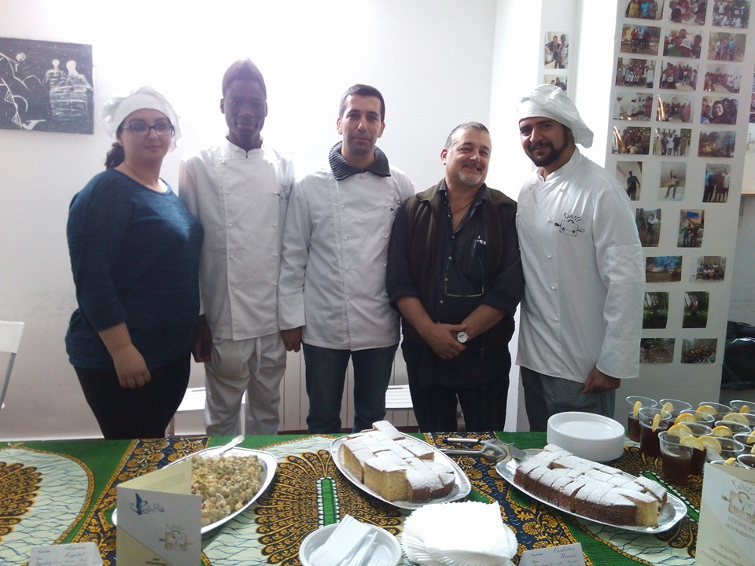
Best practices
Naples - Tobilì
(Facebook page)

Slide 30
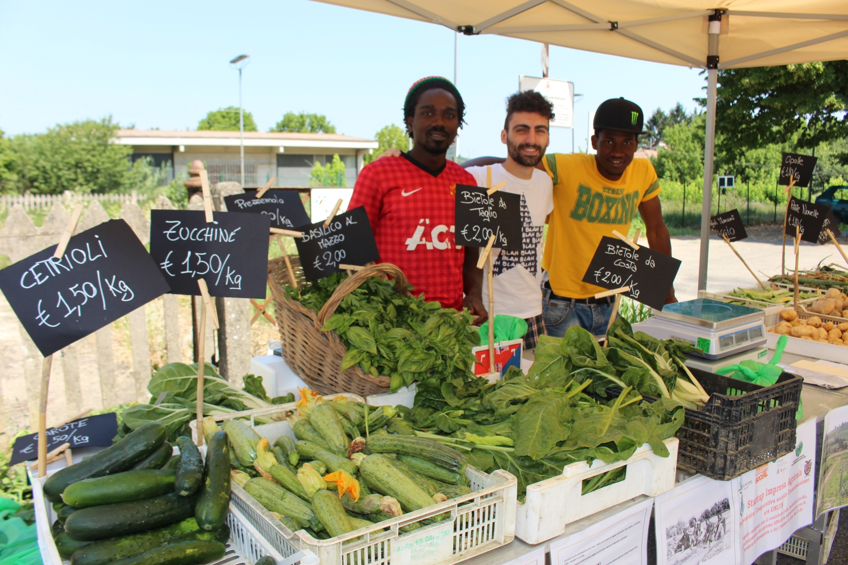

Best practices
“Maramao”
(website)

Slide 31



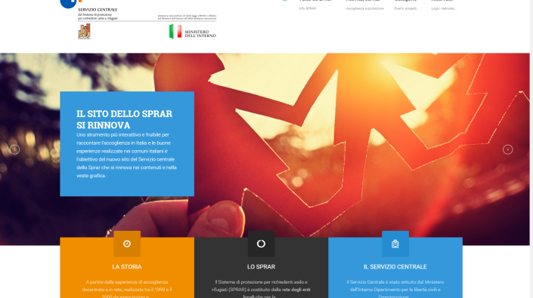
Thank you for the attention
Stay in touch with us!
Website
www.sprar.it
Follow us on Twitter
@rete_sprar
Email info@serviziocentrale.it

